Slide 1


London Weather Prediction Using Apache Spark
Course:
CSYE 7200: Big-data engineering Using SCALA
Professor:
Robin Hillyard
Team 9
Renteng Huang, ShuangShuang Xu, Balaji Mudaliyar

Slide 2


Goals of the project
To predict the future weather condition of London city(1 week).
To develop Apache - Spark Scala code to clean, train, model the data.
To use Apache - Spark Scala MLib(Machine Learning Library) to predict the weather.
We will be implementing the UI using play framework.
Collaborative learning and knowledge sharing.
Delivering each milestone on time

Slide 3
Use cases
Model input
Model Output
Weather prediction (Sunny, Cloudy, Rainy, Foggy, Clear)
Date
Temperature, Pressure

Slide 4
Methodology
The cleaning of the training dataset
Fitting of the data to the model
Making predictions based on fitted model
Calculating accuracy of the model
Save predictions
Data
Cleaning and Aggregating
Fitting/Training the data to the model
Make predictions based on the fitted model
Save predictions and test accuracy of the model
Training
Dataset
Predictions

Slide 5
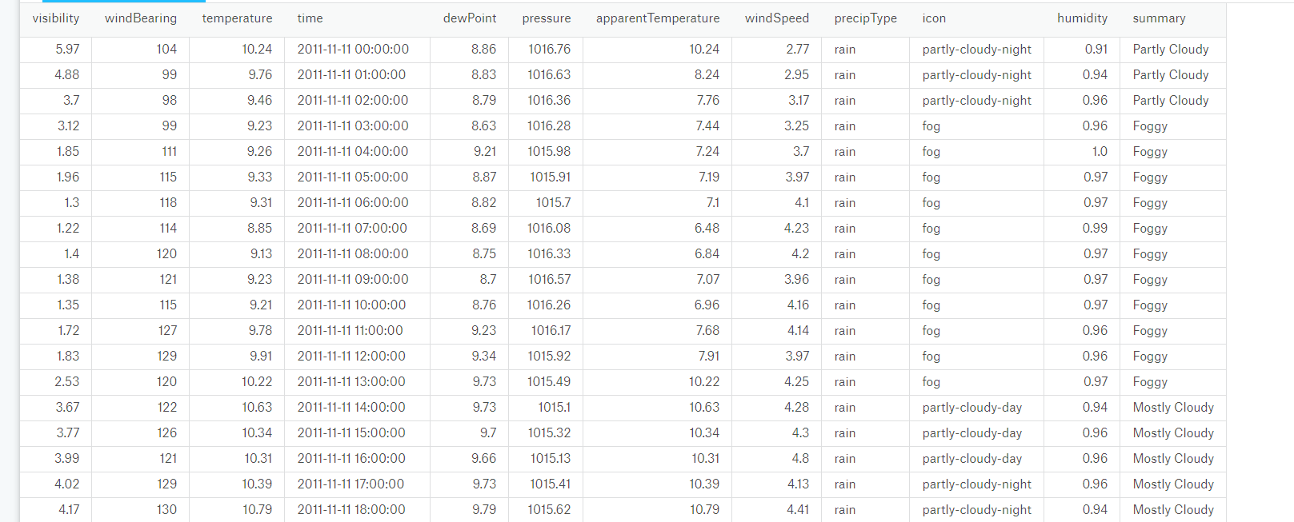
Data source
Kaggle : (https://www.kaggle.com/jeanmidev/smart-meters-in-london/data)
21000 record dataset containing hourly weather information of London city

Slide 6
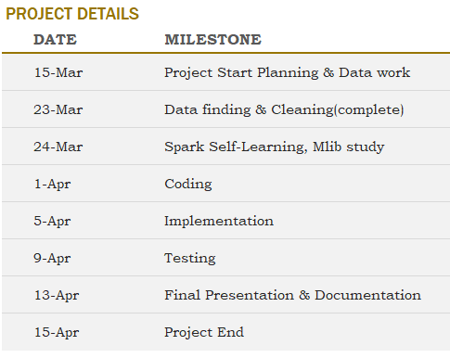
Milestones/sprints

Slide 7
Programming in Scala and code repository
Most part of the project will be programmed in Scala including
Cleaning
Splitting(Training& Testing)
Fitting/Training Data to Model
Predictions
Accuracy Calculation
Code repository : GitHub
https://github.com/001239511ShuangShuangXu/csye7200-spring2018-group9

Slide 8
Acceptance criteria
The accuracy of the model predicting weather will be correct 4/7(day/day).
Target a Root Mean Square Percentage Error (RMSPE) of 0.40

Slide 9

End

